Slide 1
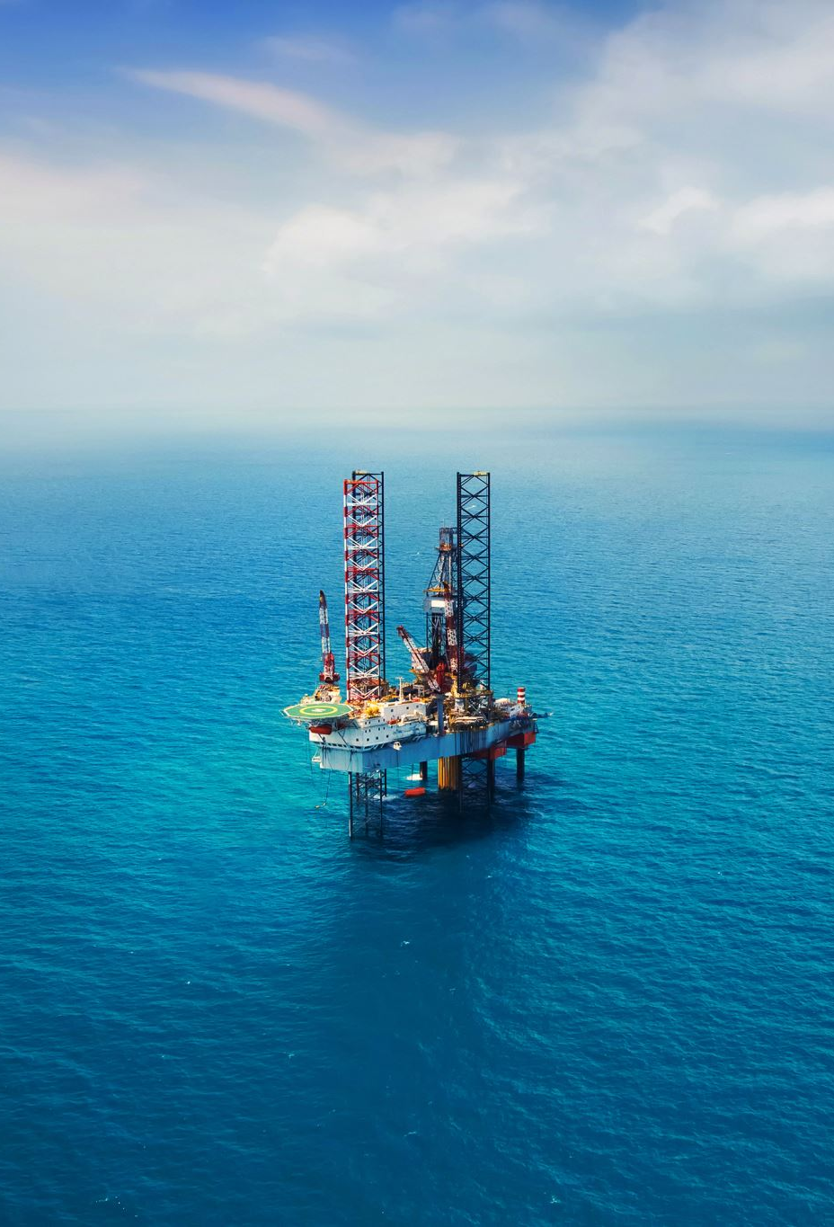
BINARY IMAGE CLASSIFICATION SYSTEM TO IDENTIFY OIL SPILLS IN OCEAN IMAGERY
TEAM
Suchendra Reddy Yalamakuru - 2313042
Shreyas Mysore Narayanan - 2307777
Surya Vardhan Reddy Puchalapalli - 2311061
Chinta Bindhu sri - 2316871
Mappavarapu Madhu Sudhan Rao - 2281268
Sreeja Reddy Nannuri - 2205712

Slide 2

CONTEXT
ABSTRACT
INTRODUCTION
BUSINESS VALUE
OBJECTIVE
METHODOLOGY
PREPROCESSING STEP FOR OIL SPILL DATASET
VISUALIZATION
DATA AUGMENTATION
MODEL BUILDING

Slide 3
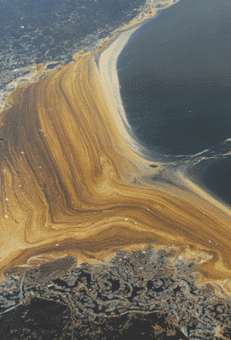
ABSTRACT
This project aims to use machine learning to detect oil spills, with data from Kaggle. After preprocessing and testing various models, the best ones were evaluated using metrics like accuracy, precision, recall, and F1 score. The top performers were then tested on a separate dataset, and a classification report was generated. The ultimate objective is to help prevent environmental disasters caused by oil spills.

Slide 4
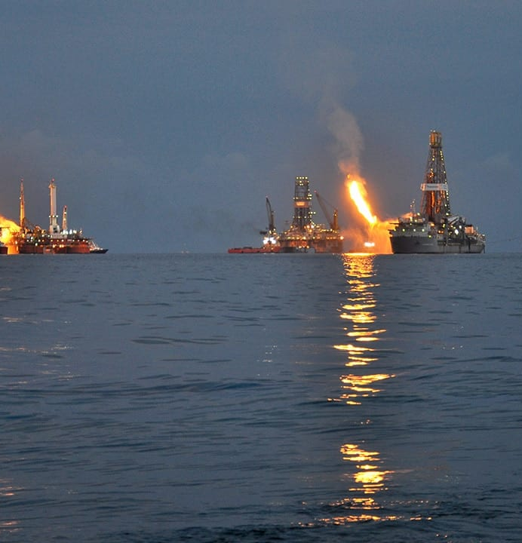
INTRODUCTION
- Oil spills pose significant threats to marine life, ecosystems, and human populations, resulting in environmental and economic damage.
- Traditional detection methods for oil spills are slow, expensive, and unreliable.
- Machine learning presents an opportunity to automate detection and alert relevant authorities promptly.
- This project's goal is to develop a binary classification model using machine learning to detect oil spills.
- The objective is to create a scalable and cost-effective solution for oil spill detection and response.

Slide 5
BUSINESS VALUE
Risk Reduction: Minimizes the chance of environmental harm and financial losses from oil spills.
Cost Savings: Automates detection, saving money on manual labor and potential cleanup expenses.
- Reputation Protection: Quick response preserves the company's image and trust among stakeholders.
Compliance: Helps meet environmental regulations, avoiding fines and legal troubles.
Innovation: Shows commitment to modern solutions, attracting eco-friendly investors and customers.

Slide 6
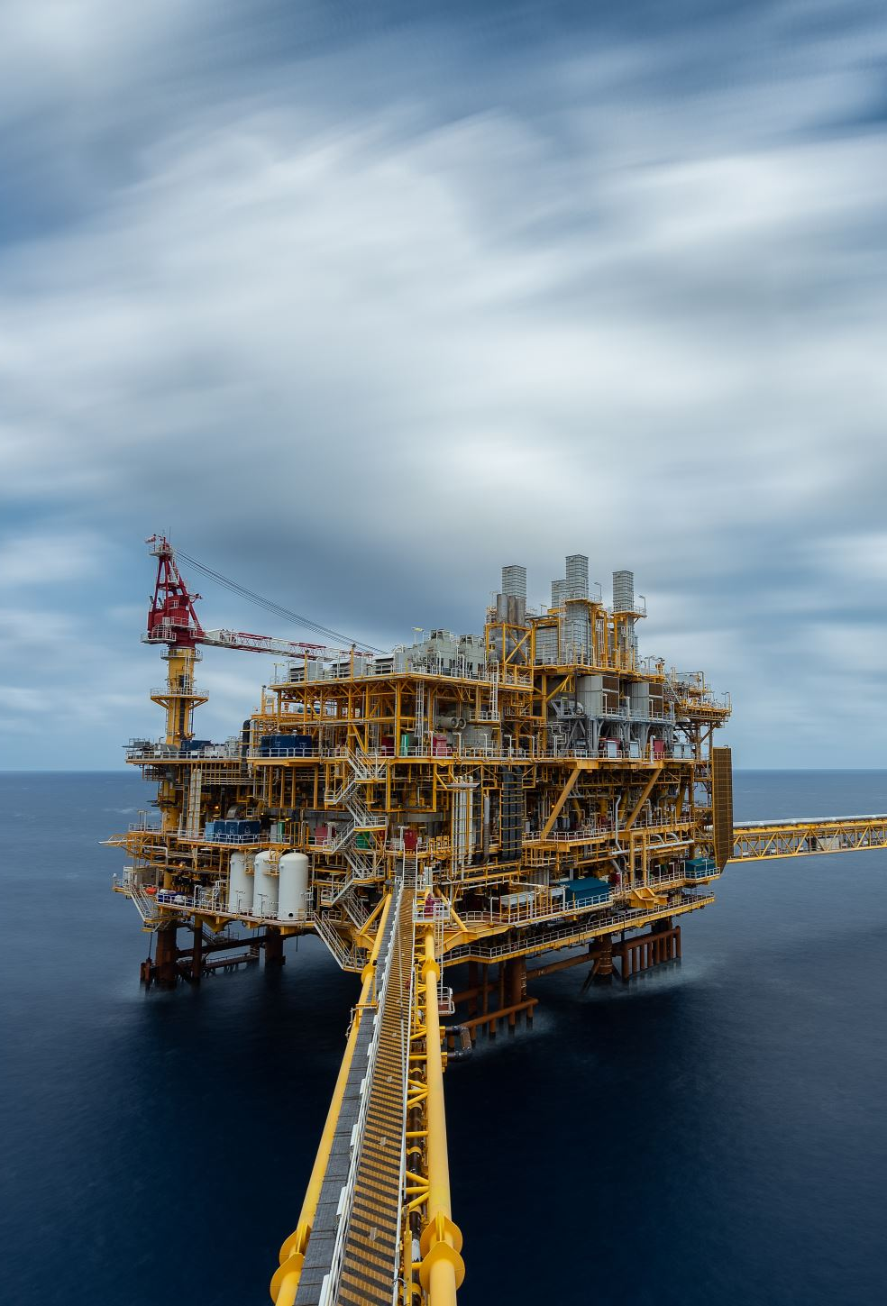
OBJECTIVE
Train it to identify spills accurately in diverse conditions.
Automate detection to save time and resources.
Alert authorities swiftly.
Prevent environmental disasters.
Provide a scalable, cost-effective solution.
Build a machine learning model to detect oil spills.

Slide 7
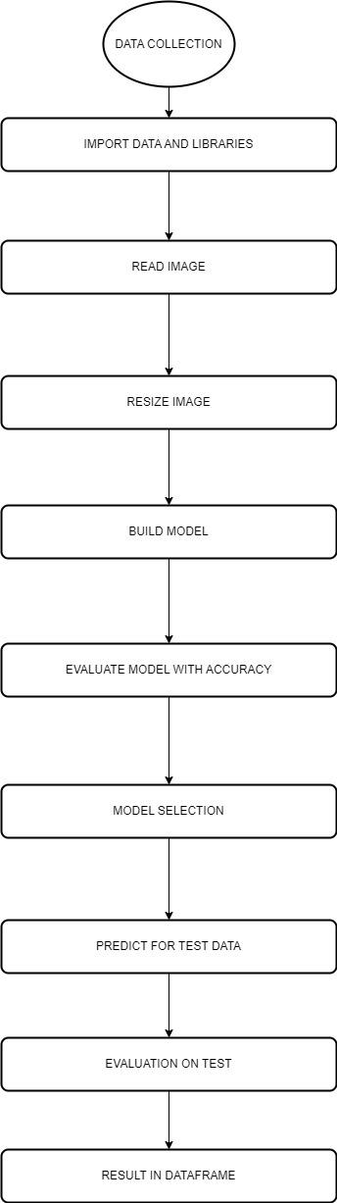
METHODOLOGY

Slide 8

Preprocessing Steps for Oil Spill Image Dataset
Collected oil spill image dataset from Kaggle.
Divided dataset into training, validation, and testing sets.
Read images using cv2 library and assigned spill or non-spill labels.
Resized all images to 180 x 180 x 3 pixels for consistency.

Slide 9

DATA AUGMENTATION
Data augmentation introduces variations to the existing dataset to increase its diversity.
It helps prevent overfitting and improves the generalization of the model.
In image classification, data augmentation can be used to improve the performance of the model.
Parameters such as rotation range, width_shift_range, height_shift_range, horizontal_flip, and vertical_flip can be used to apply data augmentation to images.
Rotation_range rotates the image by a random degree in the specified range.
Width_shift_range and height_shift_range shift the image horizontally and vertically by a fraction of its total width and height, respectively.
Horizontal_flip and vertical_flip flip the image horizontally or vertically, respectively.
By applying data augmentation, we can increase the size and diversity of the dataset, and improve the performance of the model.

Slide 10
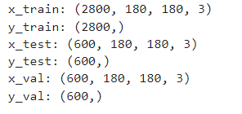
DATA SPLIT

Slide 11
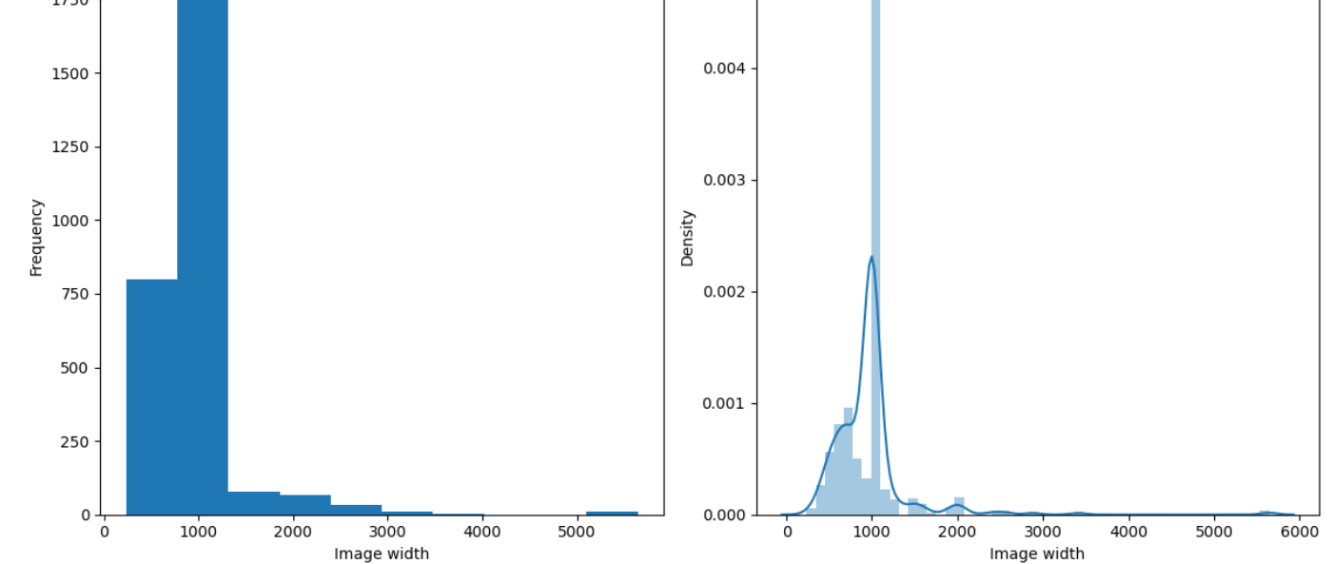
DISTRIBUTION OF IMAGE WIDTH FOR TRAINING DATA

Slide 12
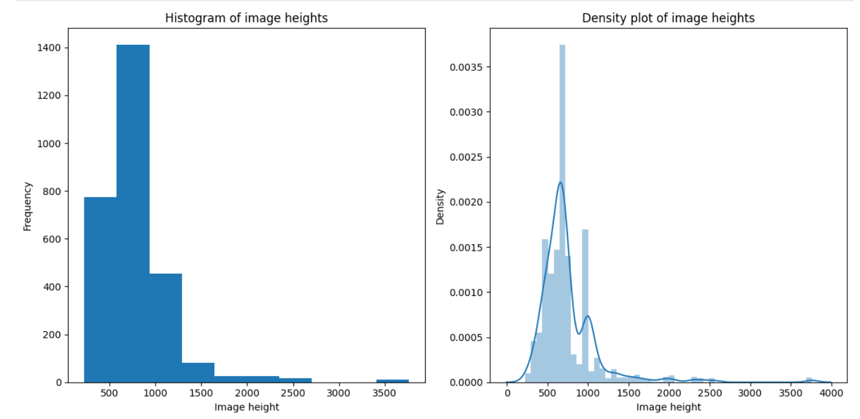
DISTRIBUTION OF IMAGE HEIGHTS FOR TRAINING DATA

Slide 13
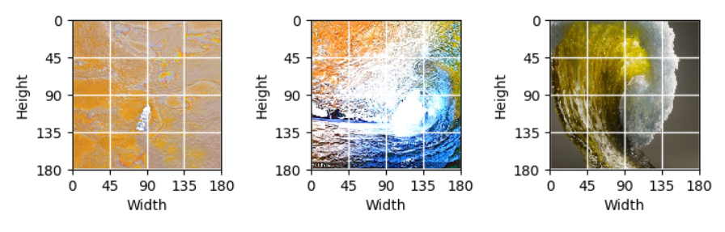
VISUALISING RESIZED IMAGE OF TEST DATASET

Slide 14
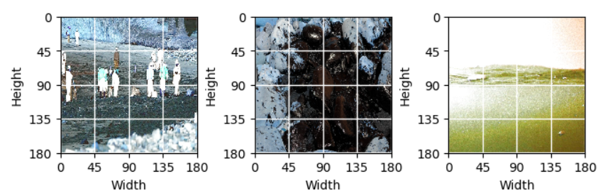
VISUALISING RESIZED IMAGE TRAINING SET

Slide 15
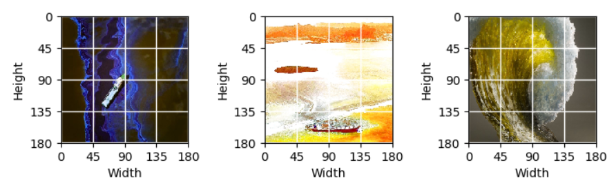
VISUALISING RESIZED IMAGE VALIDATION SET

Slide 16
MODEL BUILDING
VGG-19
SVM
LOGISTIC REGRESSION
RANDOM FOREST
GRADIENT BOOSTING
EXTREME GRADIENT BOOSTING

Slide 17
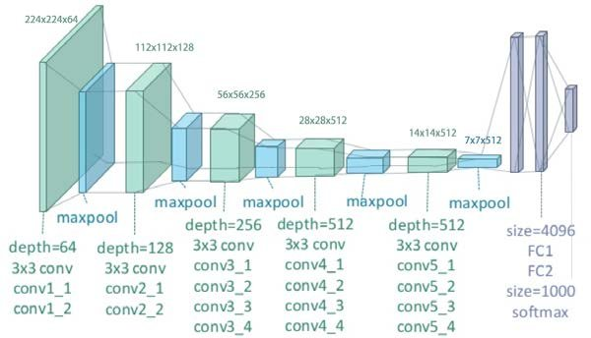
VGG-19 ARCHITECTURE
VGG-19 is a CNN architecture that consists of 19 layers, including 16 convolutional layers and 3 fully connected layers.
Max pooling is applied after every two or three convolutional layers.
The output of the last convolutional layer is flattened and fed into fully connected layers, with 4,096 neurons in the first two layers and the number of classes in the last layer.

Slide 18
VGG-19 FOR BINARY CLASSIFICATION
VGG-19 can be used for binary image classification by adapting it to classify images into one of two classes.
The last layer of VGG-19, designed for ImageNet dataset, needs to be replaced with a fully connected layer with 2 units for binary classification(Spill or No Spill).
We can freeze the lower layers of VGG-19, which have already learned low-level features, and only train the last few layers added for binary classification.
Techniques such as data augmentation can be used to increase the diversity of training data and prevent overfitting.
After training, the model can be evaluated on a held-out test set to measure its accuracy and other metrics.
If the model performs well, it can be used to classify new images as belonging to one of the two classes.

Slide 19
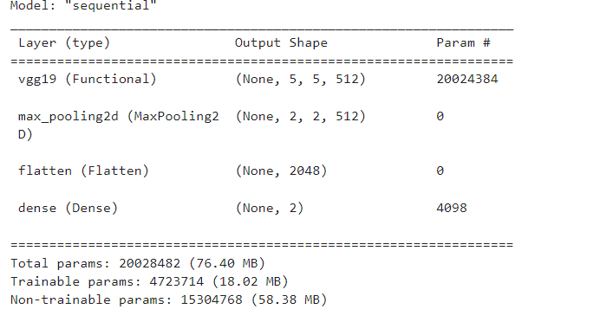
VGG-19 MODEL

Slide 20
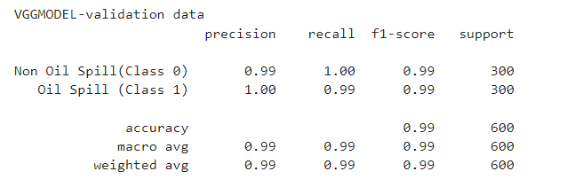
VGG MODEL VALIDATION

Slide 21
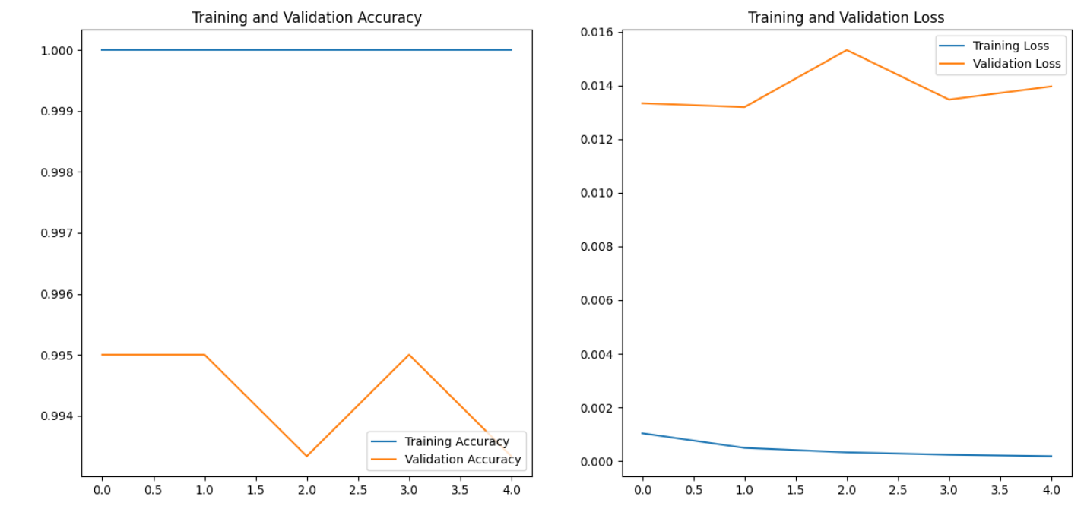
VGG-19 MODEL EVALUATION

Slide 22

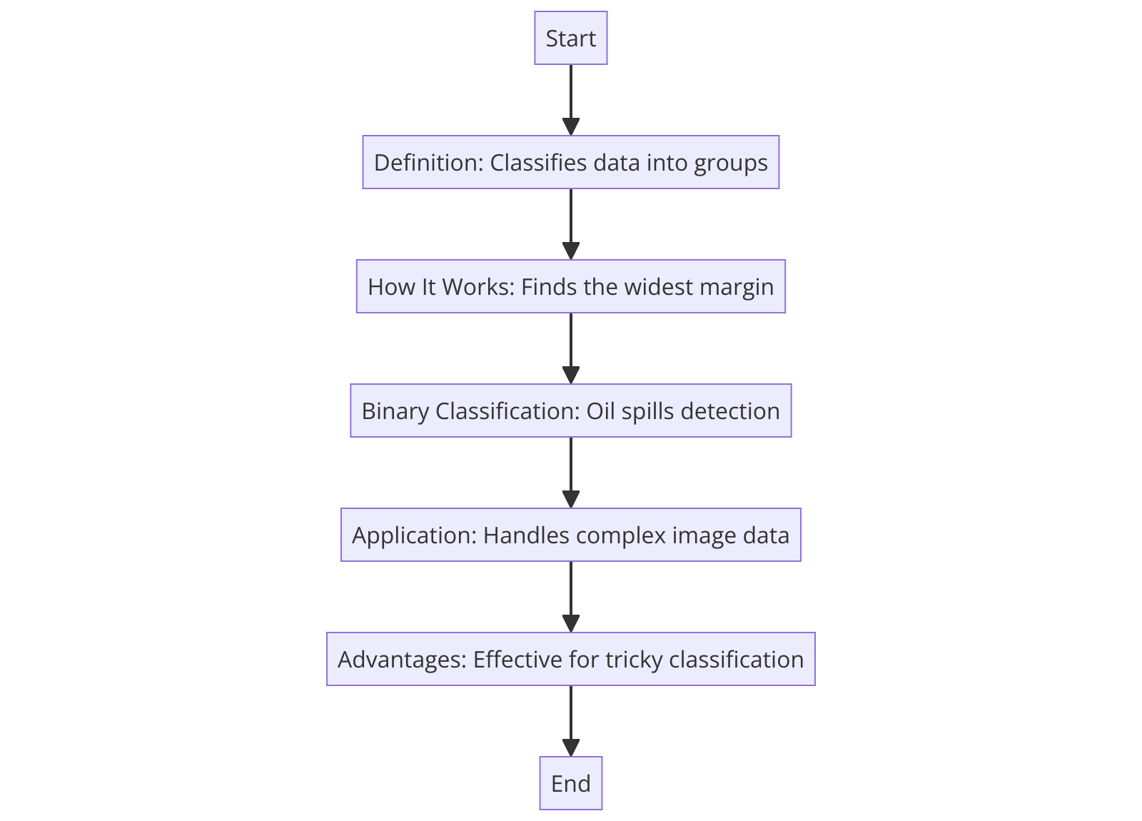
SUPPORT VECTOR MACHINE
Definition: SVM is a machine learning method mainly used for classifying data into different groups by finding the best dividing line or hyperplane.
How It Works: It looks for the widest possible separating margin between classes, ensuring the chosen hyperplane is the best at separating different categories.

Slide 23
SUPPORT VECTOR MACHINE
For tasks like identifying oil spills in satellite images, SVM separates the images into two groups: with oil spills and without.
It's great for detecting oil spills because it can handle complex image data and find patterns even when they're not obvious.
It's reliable and effective for tricky classification problems, making it a strong choice for sorting through intricate image data, like distinguishing environmental features.

Slide 24
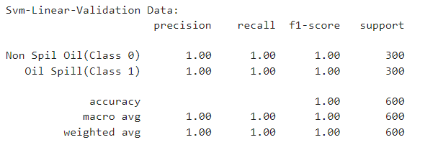
SVM LINEAR VALIDATION

Slide 25
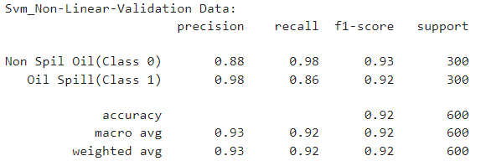
SVM_NON-LINEAR VALIDATION

Slide 26
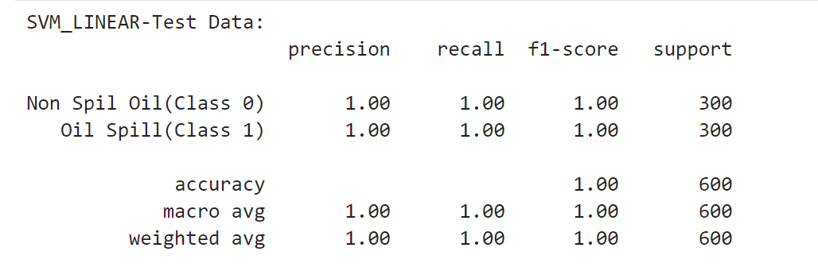
PERFORMANCE EVALUATION OF SELECTED MODEL SVM LINEAR

Slide 27
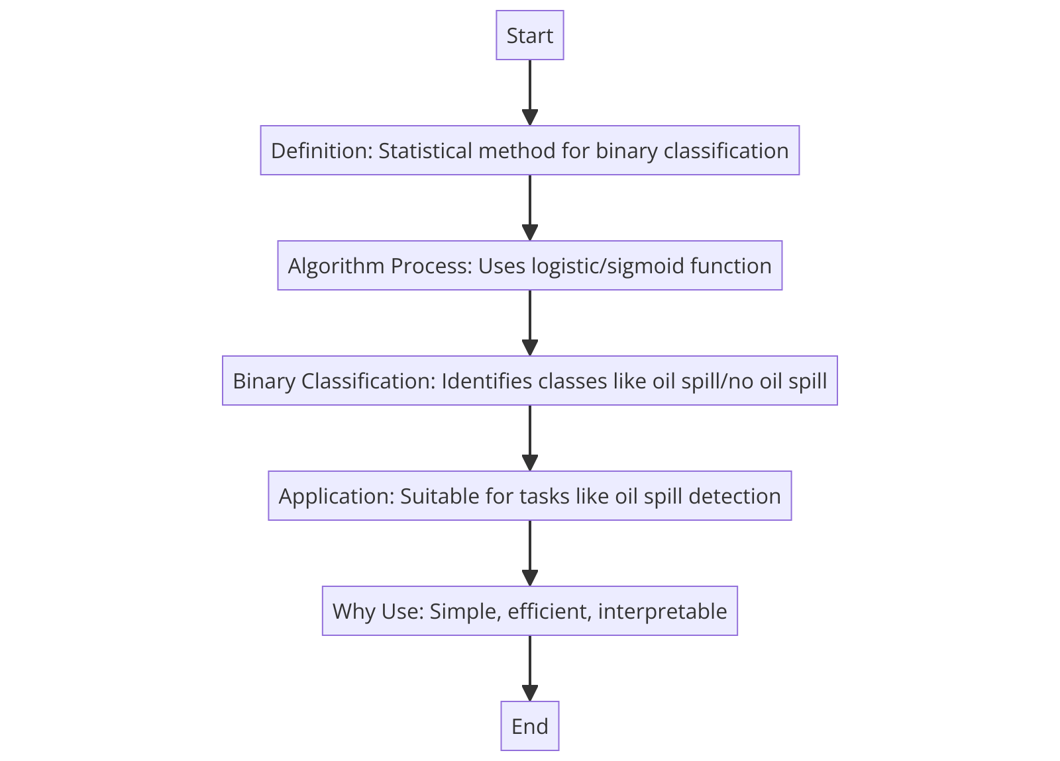
LOGISTIC REGRESSION
Logistic Regression is a statistical method used for binary classification tasks, which predicts the probability that a given input point belongs to a certain class.
It uses the logistic function (or sigmoid) to transform linear combinations of input features into values between 0 and 1, representing the probability of class membership.

Slide 28
LOGISTIC REGRESSION
In the context of binary image classification, like identifying oil spills in ocean imagery, Logistic Regression will classify each pixel or image region as either "oil spill" (class 1) or "no oil spill" (class 0).
Logistic Regression is suitable for this task because it can handle varied input features (like color, texture, and pattern) to compute the likelihood of oil presence in water, providing a clear decision boundary between the two classes.
It is chosen for its simplicity, efficiency, and interpretability in binary classification problems. Its output can be directly interpreted as probabilities, which is valuable for decision-making in environmental monitoring.

Slide 29
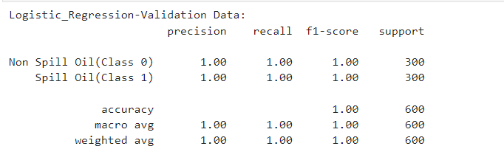
LOGISTIC REGRESSION

Slide 30
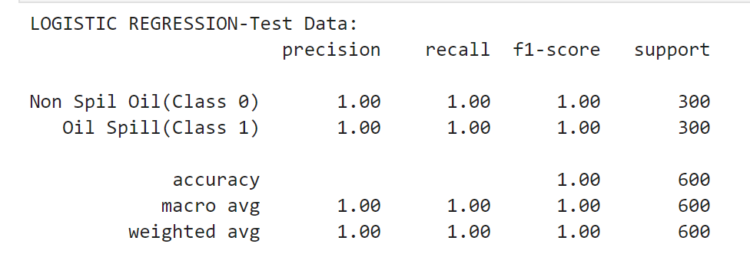
PERFORMANCE EVALUATION OF SELECTED MODEL LOGISTIC REGRESSION

Slide 31
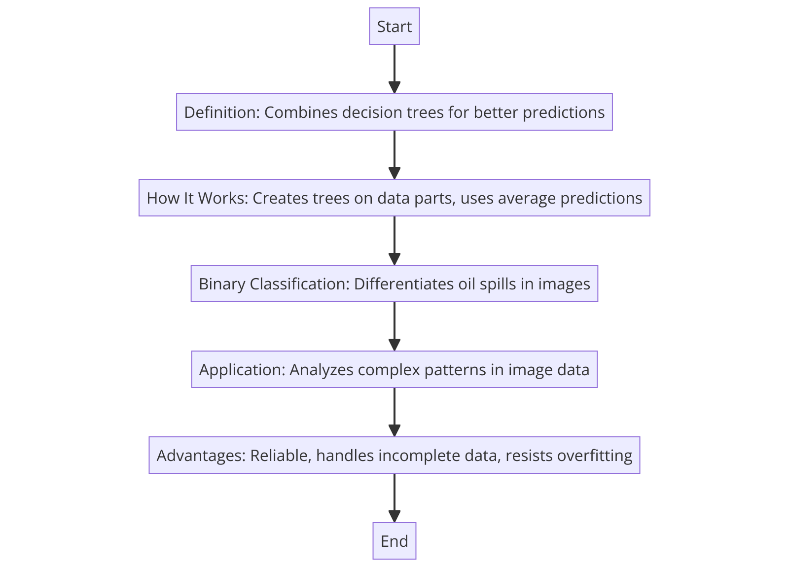
RANDOM FOREST
Definition: Random Forest combines many decision trees to make more accurate predictions or classifications than a single tree would.
How It Works: It creates a bunch of decision trees on different parts of the data and uses their average predictions for better accuracy and less overfitting.

Slide 32
RANDOM FOREST
Binary Classification: For identifying oil spills from images, Random Forest looks at various image features in many trees to determine if there's an oil spill or not.
Application for Oil Spills: It's good at detecting oil spills in images because it can analyze complex patterns and handle lots of data.
Advantages: Random Forest is reliable, can deal with incomplete data, and doesn’t easily overfit, making it effective for environmental monitoring like tracking oil spills.

Slide 33
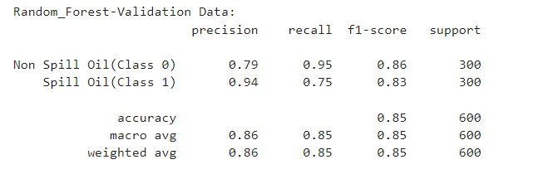
RANDOM FOREST VALIDATION

Slide 34
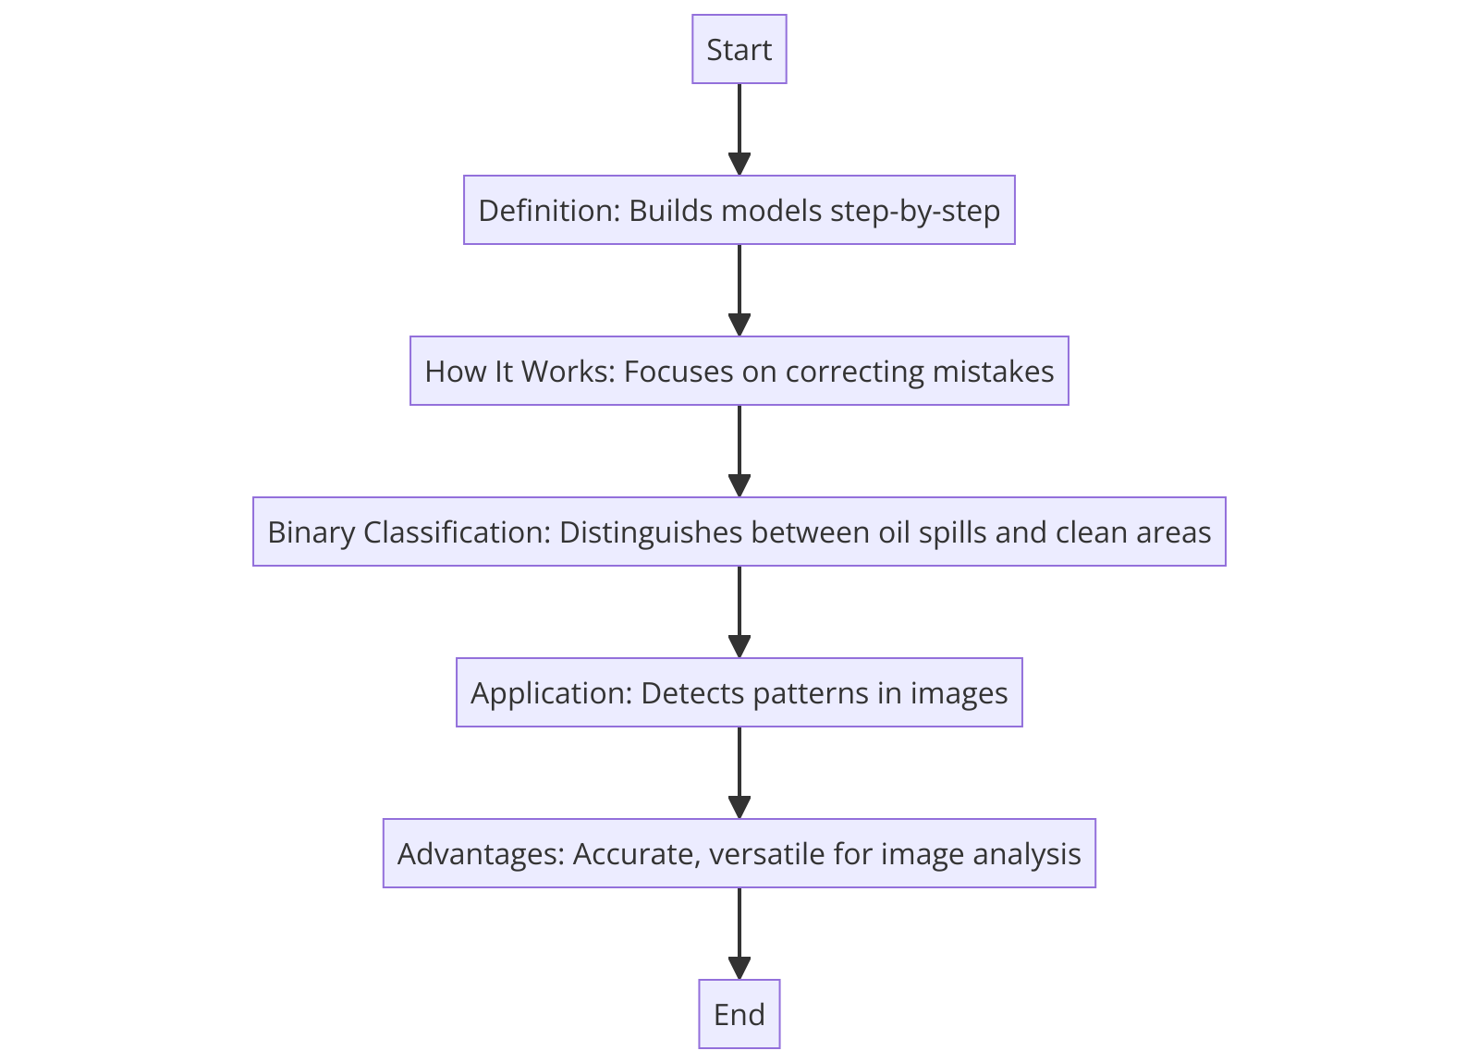
GRADIENT AND EXTREME GRADIENT BOOSTING
Gradient Boosting
Builds models step-by-step, each new model fixing errors from the previous ones.
Focuses on correcting previous mistakes, gradually improving accuracy.
Learns from image data to better distinguish between oil spills and clean areas.
Can detect subtle patterns in images, making it good for spotting oil spills.
Highly accurate and versatile, ideal for detailed image analysis.

Slide 35
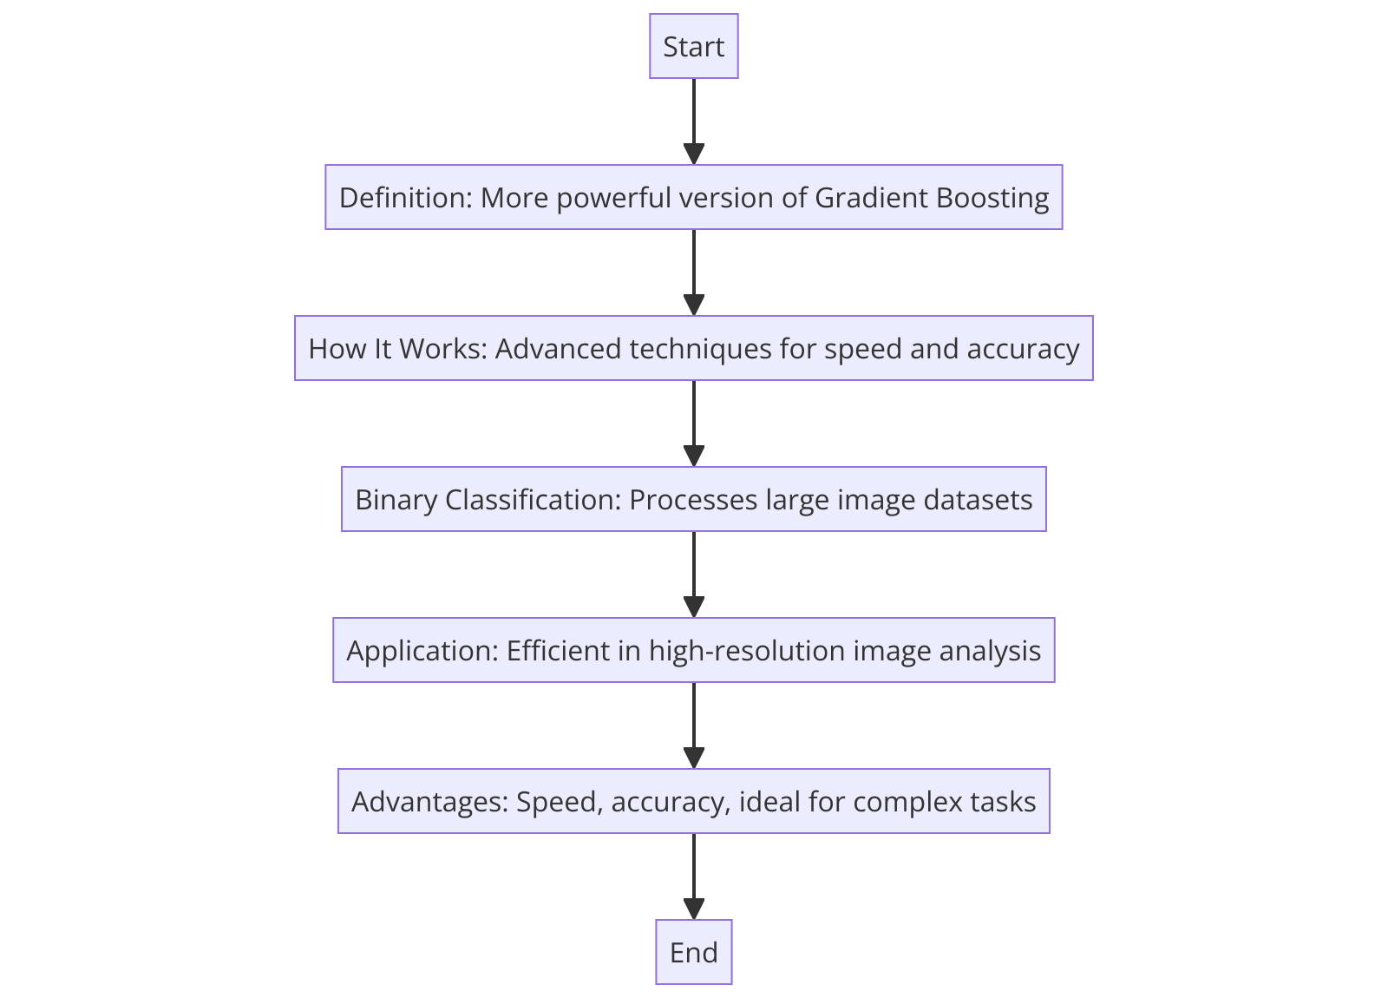
GRADIENT AND EXTREME GRADIENT BOOSTING
Extreme Gradient Boosting (XGBoost)
A faster, more powerful version of Gradient Boosting that handles big data efficiently.
Uses advanced techniques for quick, accurate model building.
Quickly processes large image datasets to identify oil spills.
Fast and precise, great for analyzing high-resolution satellite images for oil spills.
Known for speed and accuracy, perfect for complex tasks like tracking oil

Slide 36
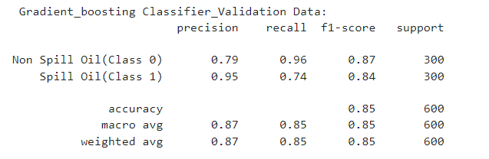
GRADIENT BOOSTING CLASSIFIER

Slide 37
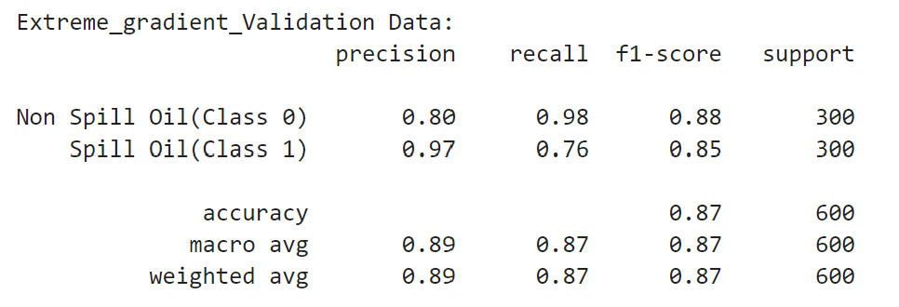
EXTREME GRADIENT BOOSTING

Slide 38
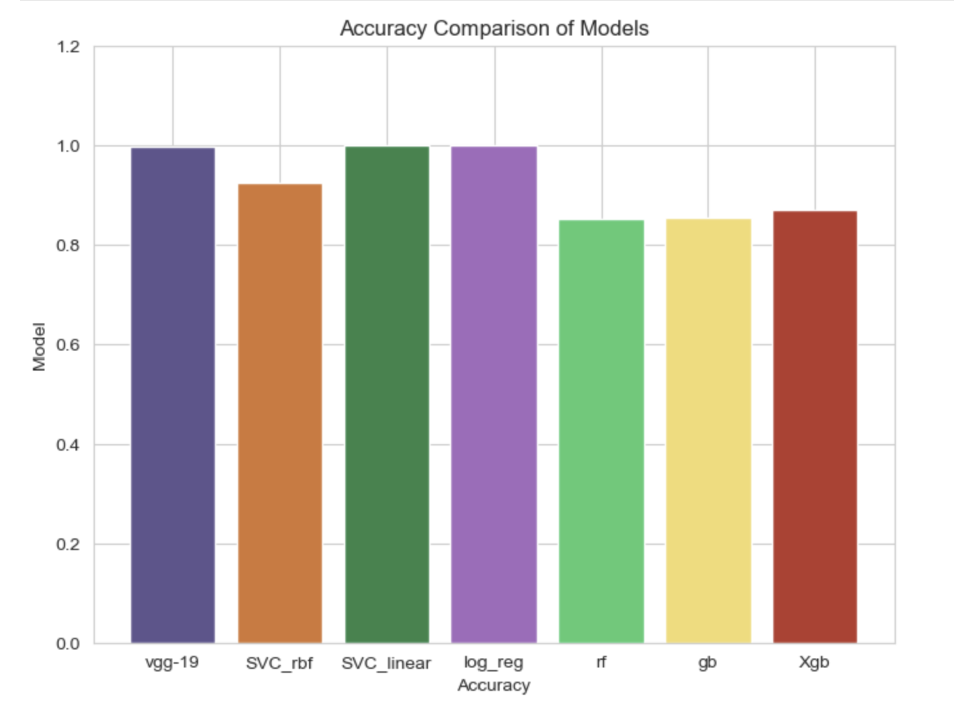
MODELS ACCURACY COMPARISONS

Slide 39
PERFORMANCE EVALUATION OF SELECTED MODEL VGG-19

Slide 40
PERFORMANCE EVALUATION OF SELECTED MODEL SVM LINEAR

Slide 41
PERFORMANCE EVALUATION OF SELECTED MODEL LOGISTIC REGRESSION

Slide 42
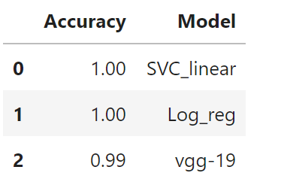
FINAL PREDICTED ACCURACY OF SELECTED MODELS ON TEST DATA SET

Slide 43

THANK YOU

